Slide 1

SUNFLOWER
A solar tracking system using light-sensing logic to maximize energy harvesting
Alessandro Weber
Matteo Zambon
Giacomo Castellan
Embedded Software for the Internet of Things project

Slide 2
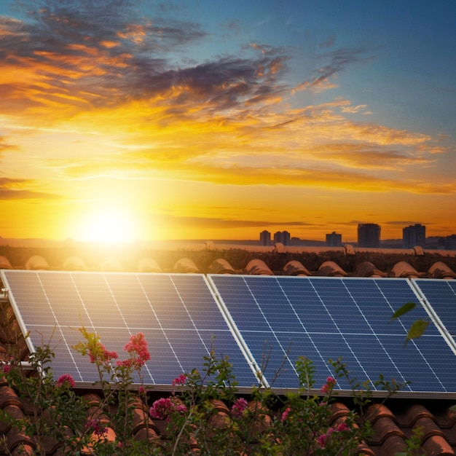
Problem statement
Traditional solar installations often suffer from significant energy loss (10-30% of potential energy every day) due to their static positioning.
Sunflower project addresses these inefficiencies by implementing a solar tracking system.

Slide 3
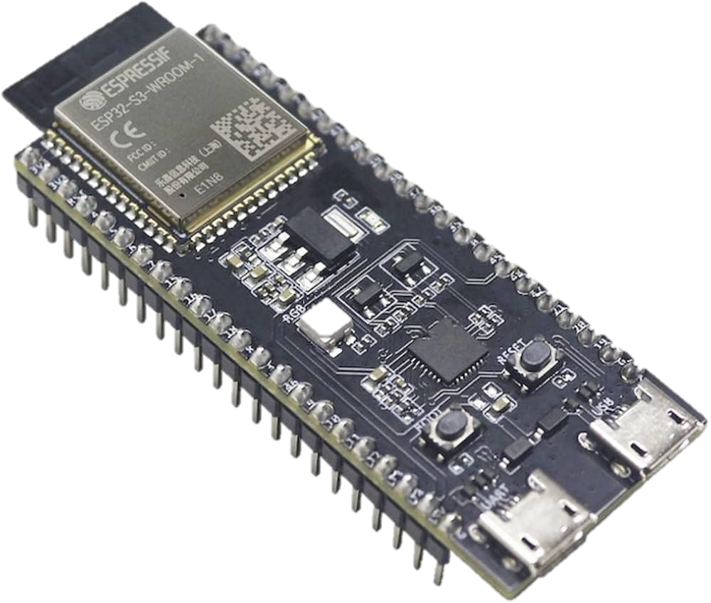
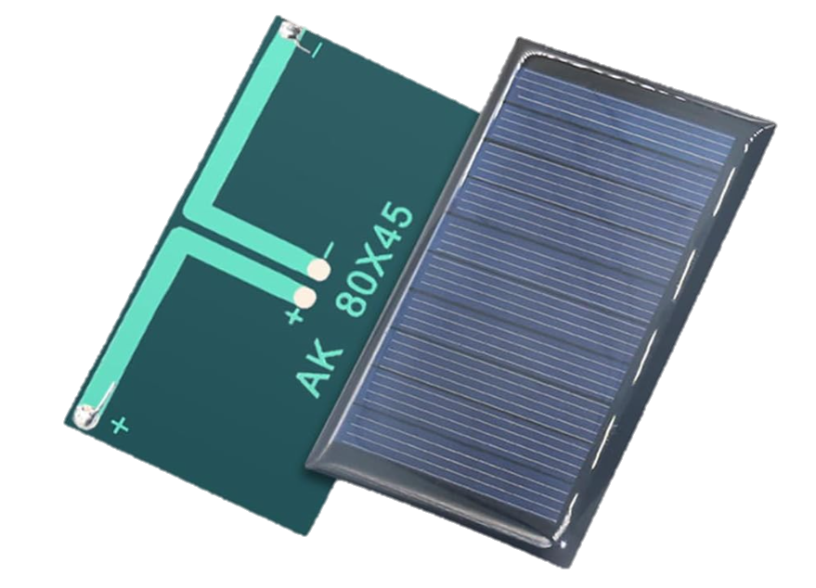
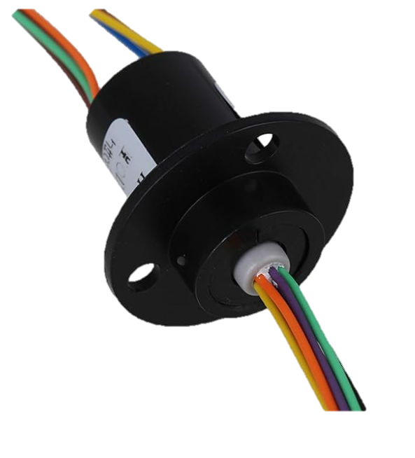
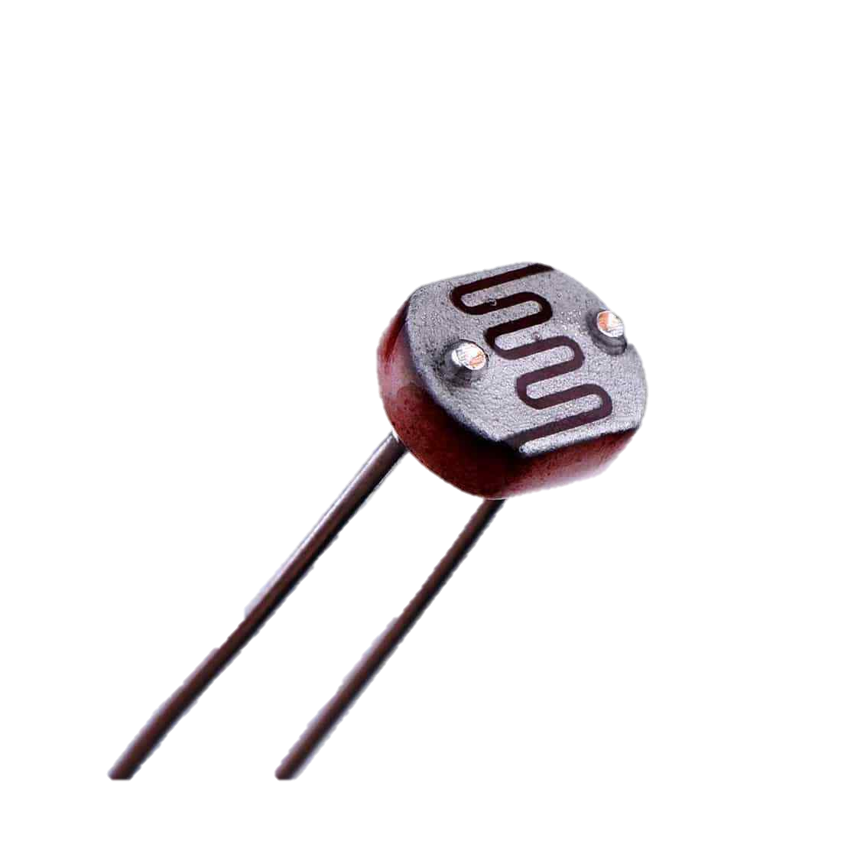
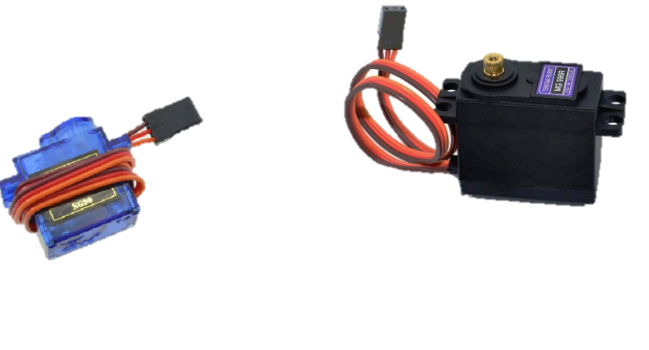
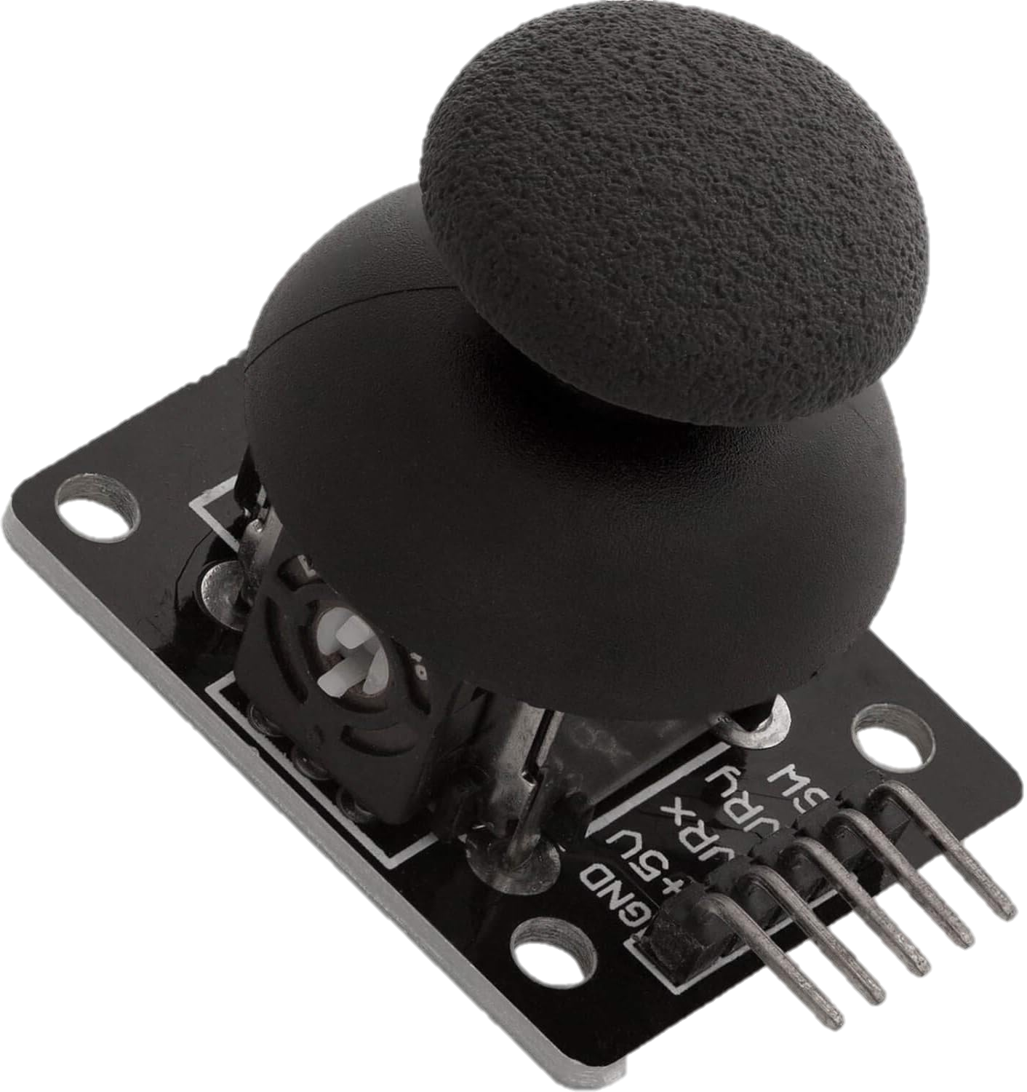
HARDWARE USED
Slip Ring (8 WIRE)
ESP32 S3
Solar Panel
Servomotors
Joystick
Photoresistor

Slide 4
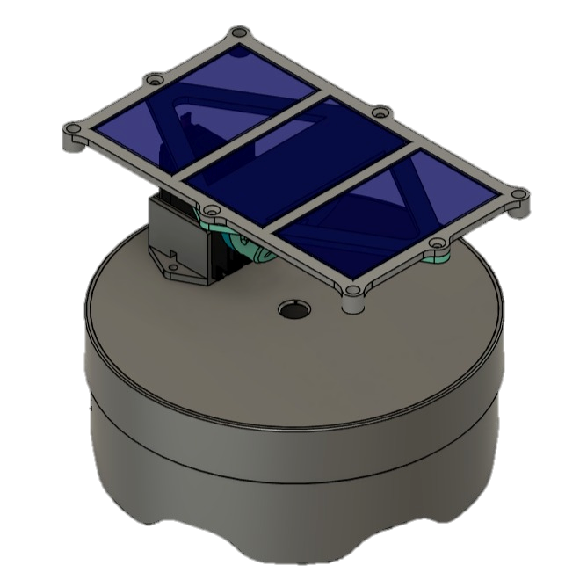
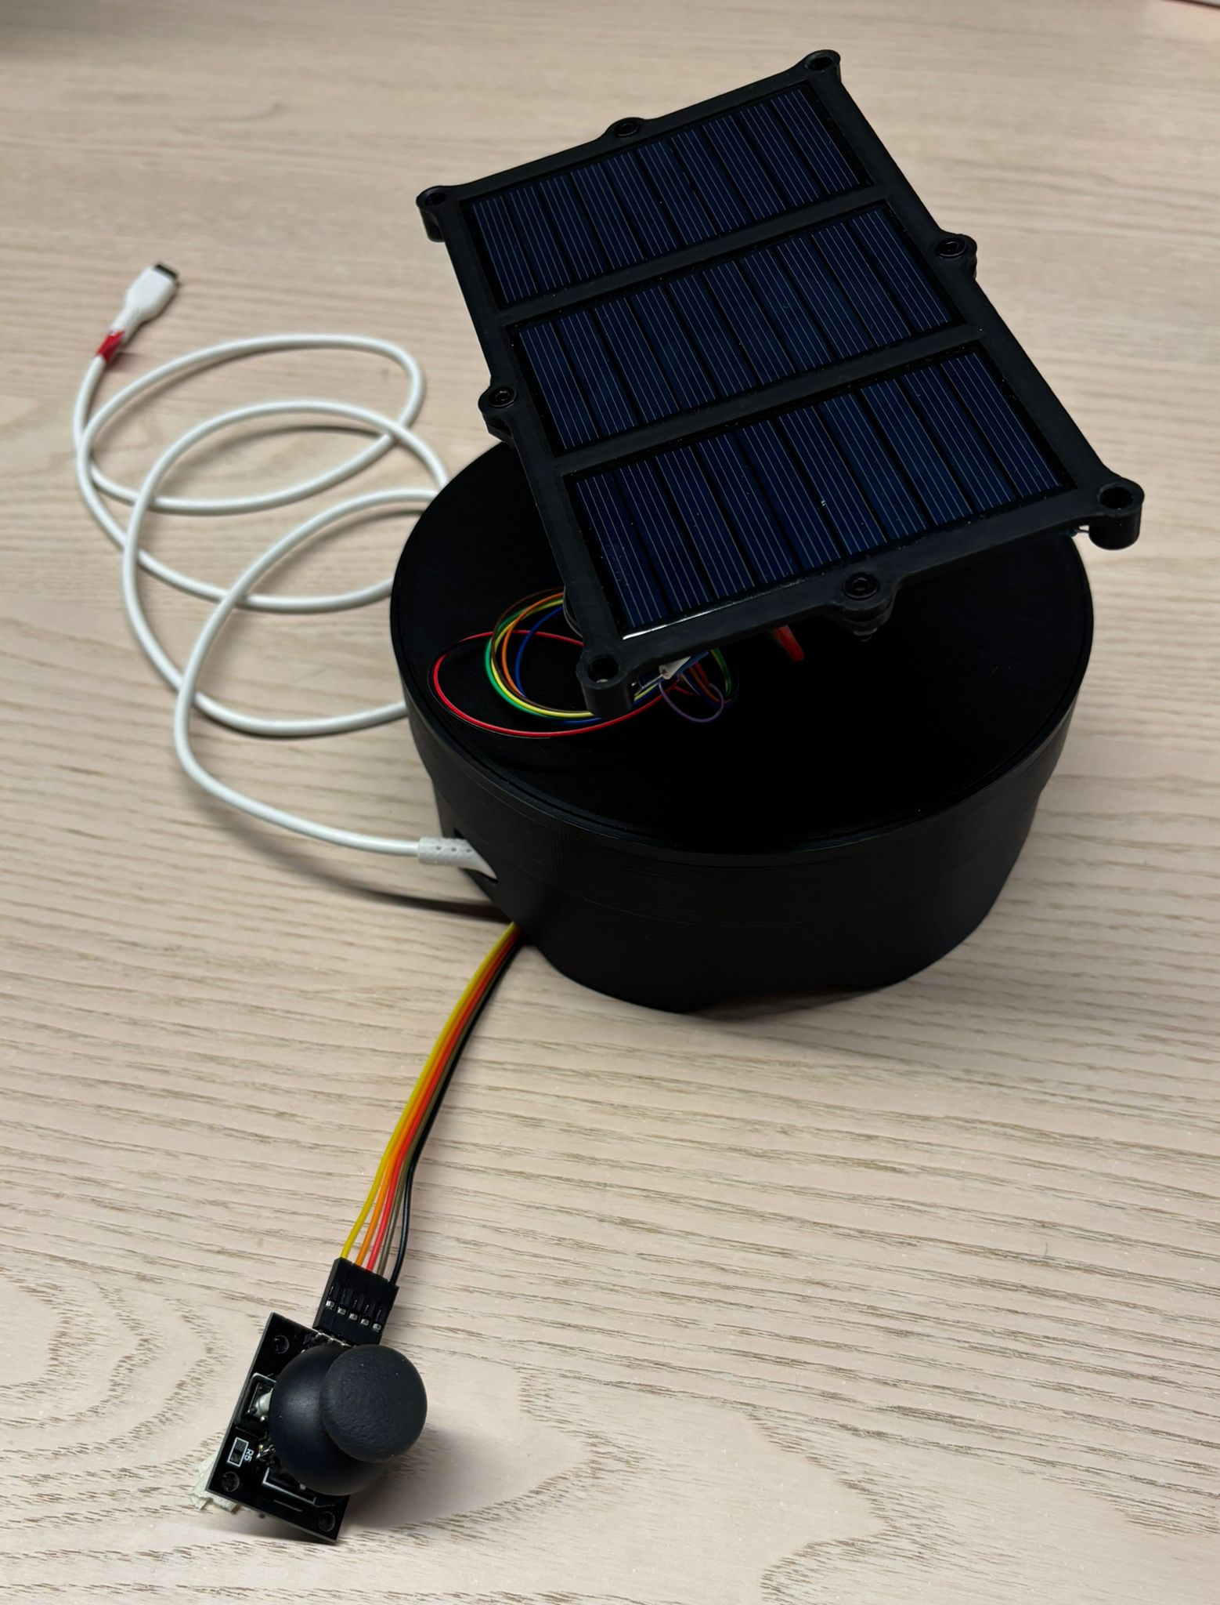
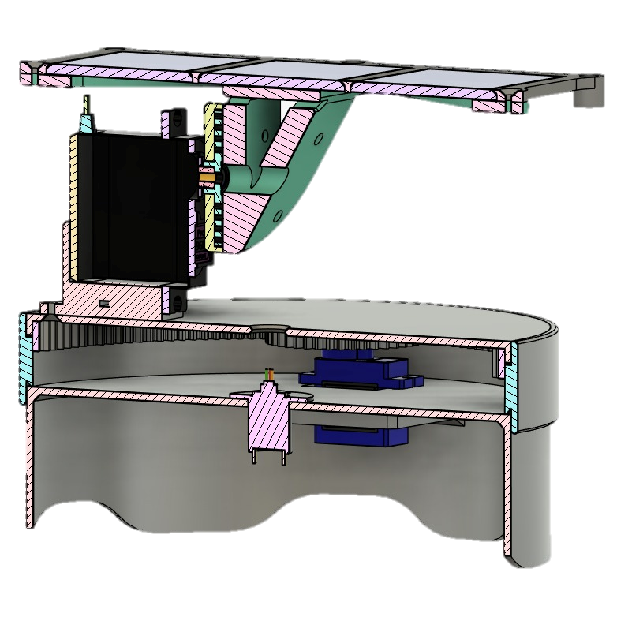
HARDWARE USED
Solar Panel
Photoresistor
Servomotor
Servomotor
Joystick
Slip Ring

Slide 5
Testing and problems

Slide 6
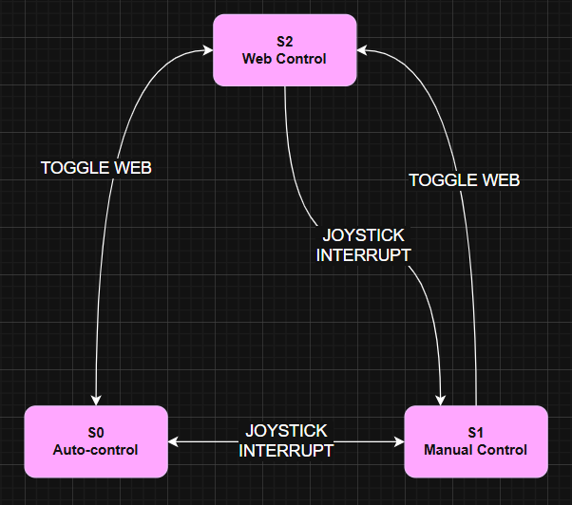
fsm diagram
AGGIUNGERE CODICE DIOCANE

Slide 7
Future improvements
Energy Monitoring:
Self-Powering: By adding an internal battery, the panel uses the energy produced to power itself.
Weather Forecast via API: Using OpenWeatherMap we check the weather in the area surrounding the panel and if a storm or hail is forecast it could move to a safety position (flat or vertical) to protect the cells

Slide 8
Who did what

